Slide 1
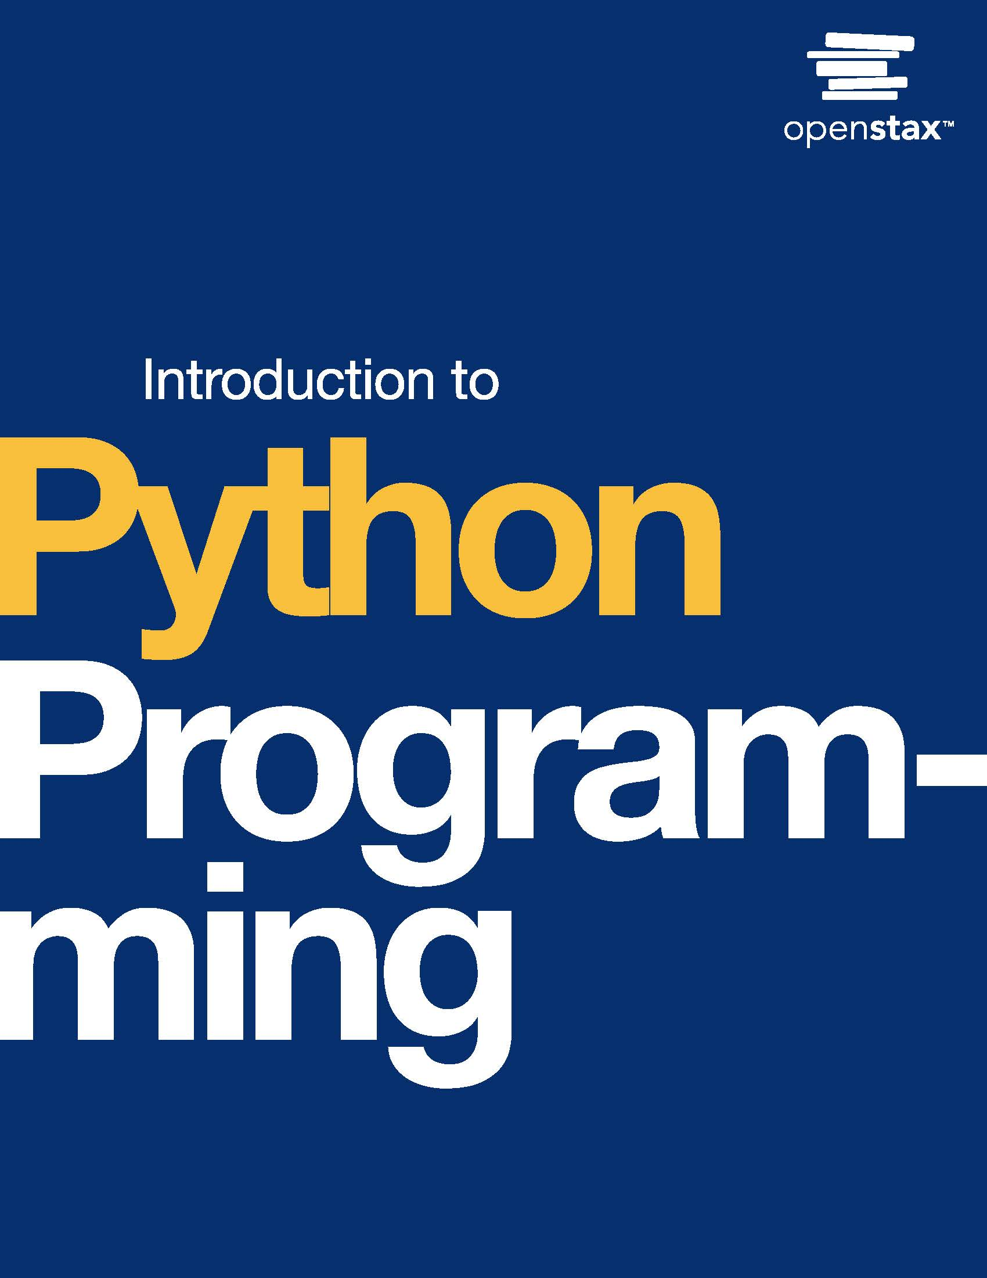
Introduction to Python Programming
Chapter 14: Files

Slide 2
Chapter outline
Reading from files
Writing to files
Files in different locations and working with CSV files
Handling exceptions
Raising exceptions

Slide 3
14.1 Reading from files
Learning Objectives
Understand how to open a file using the open() function.
Demonstrate how to read information from a file using read(), readline(), and readlines().

Slide 4
14.1 Reading from files
Opening a file
Reading information from and writing information to files is a common task in programming.
Python supports the opening of a file using the open() function.

Slide 5
14.1 Reading from files
Using read() and reading lines
Python provides functions that can be called on a file object for reading the contents of a file:
The read() function reads the contents of a file and returns a string.
The readline() function reads the next line in a file and returns a string.
The readlines() function reads the individual lines of a file and returns a string list containing all the lines of the file in order.

Slide 6
14.2 Writing to files
Learning Objectives
Understand how to open a file for writing.
Explain different modes for opening a file in Python.
Demonstrate the use of the write() function to write to a file.
Understand the importance of closing a file.

Slide 7
14.2 Writing to files
Opening a file for writing
A file may be opened for reading, allowing no changes, or for writing, allowing changes to occur in the file.
The mode defines whether a file is opened for reading only or for writing. The default mode of the open() function is reading only. A second mode parameter defines the mode.
Ex: open("output.txt", 'w') opens the output.txt file in writing mode. The following table lists common modes.

Slide 8
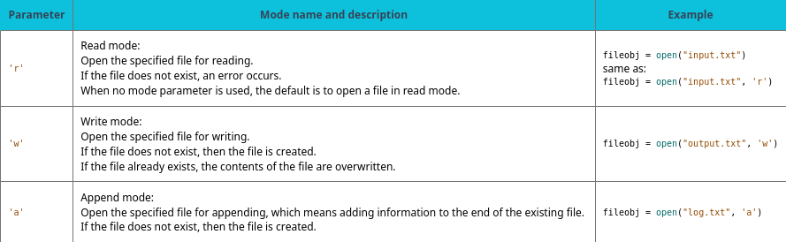
Table 14.1 Modes for the open() function.

Slide 9
14.3 Files in different locations and working with CSV files
Learning Objectives
Demonstrate how to access files within a file system.
Demonstrate how to process a CSV file.

Slide 10
14.3 Files in different locations and working with CSV files
Opening a file at any location
When only the filename is used as the argument to the open() function, the file must be in the same folder as the Python file that is executing.
Ex: For fileobj = open("file1.txt") in files.py to execute successfully, the file1.txt file should be in the same folder as files.py.
Often a programmer needs to open files from folders other than the one in which the Python file exists.
A path uniquely identifies a folder location on a computer. The path can be used along with the filename to open a file in any folder location.
Ex: To open a file named logfile.log located in /users/turtle/desktop the following can be used:
fileobj = open("/users/turtle/desktop/logfile.log")

Slide 11
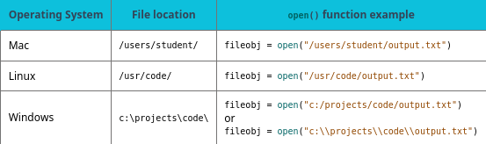
Table 14.2 Opening files on different paths.

Slide 12
14.3 Files in different locations and working with CSV files
Working with CSV files
In Python, files are read from and written to as Unicode by default. Many common file formats use Unicode such as text files (.txt), Python code files (.py), and other code files (.c,.java).
Comma separated value (CSV, .csv) files are often used for storing tabular data. These files store cells of information as Unicode separated by commas. CSV files can be read using methods learned thus far, as seen in the example below.

Slide 13
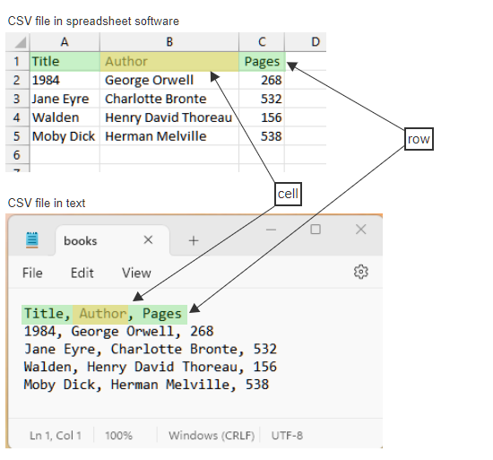
Figure 14.2
CSV files. A CSV file is simply a text file with rows separated by newline \n characters and cells separated by commas.
Notes:
CSV files. A CSV file is simply a text file with rows separated by newline \n characters and cells separated by commas.

Slide 14
14.4 Handling exceptions
Learning Objectives
Describe two exceptions that may occur when reading files.
Write try/except statements that handle built-in exceptions.

Slide 15
14.4 Handling exceptions
Runtime errors
Various errors may occur when reading a file:
FileNotFoundError: The filename or path is invalid.
IndexError/ValueError: The file's format is invalid.
Other errors caused by invalid contents of a file.
When an error occurs, the program terminates with an error message.

Slide 16
14.4 Handling exceptions
Try and except
Programs can be designed to handle exceptions, rather than terminate.
A try statement runs code that might raise an exception.
An except clause runs code in response to the exception.

Slide 17
14.5 Raising exceptions
Learning Objectives
Use a raise statement to indicate that user input is invalid.
Explain the flow of execution when an exception is raised.

Slide 18
14.5 Raising exceptions
The raise statement
A program can raise an exception when an error is detected. Raising an exception forces a program to deal with the error.
If the exception is not handled using try and except, the program displays an error message and terminates.

Slide 19
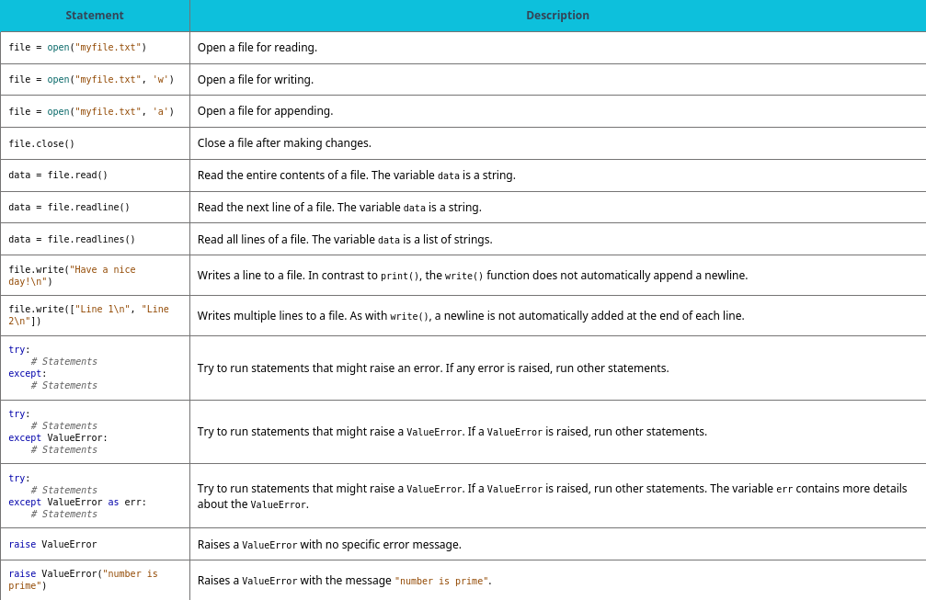
Chapter 14 reference.

Slide 20
This ancillary resource is licensed under a Creative Commons Attribution-NonCommercial-ShareAlike 4.0 (CC BY NC-SA) license; it may be distributed, remixed, built upon for noncommercial purposes only, and must be attributed to OpenStax and redistributed under the same license.

